Slide 1

(A Whirlwind) Introduction to Machine Learning in R
November 5, 2024

Slide 2
Agenda
Introduction to machine learning (ML)
ML approaches
Supervised learning
Unsupervised learning
Dataset overview
Coding practice

Slide 3
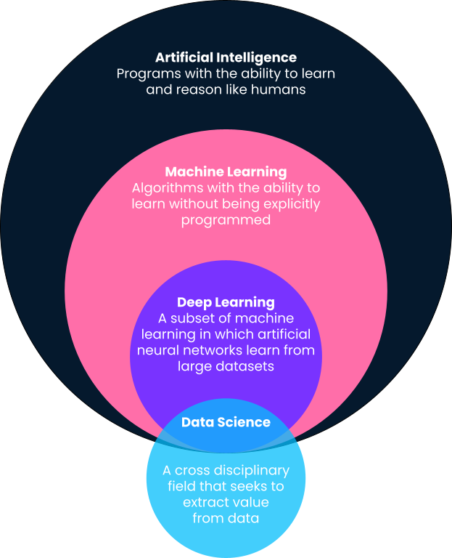
Introduction to Machine Learning
What is machine learning (ML)?
A branch of artificial intelligence that involves the development and evaluation of statistical models and algorithms that learn from data without following explicit instructions.
ML has applications across industries:
Disease prediction
Drug discovery
Financial risk assessment
Computer vision for self-driving cars
Supply chain optimization
Social media personalization
…and many others
https://www.datacamp.com/blog/what-is-machine-learning

Slide 4
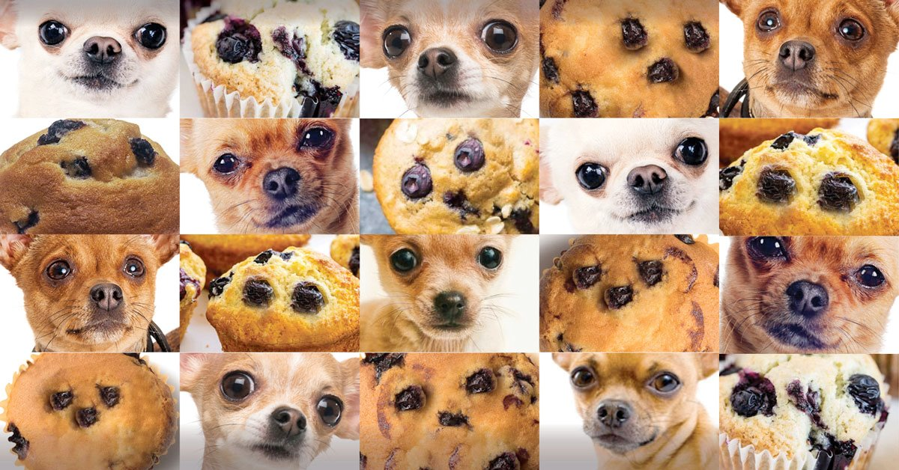
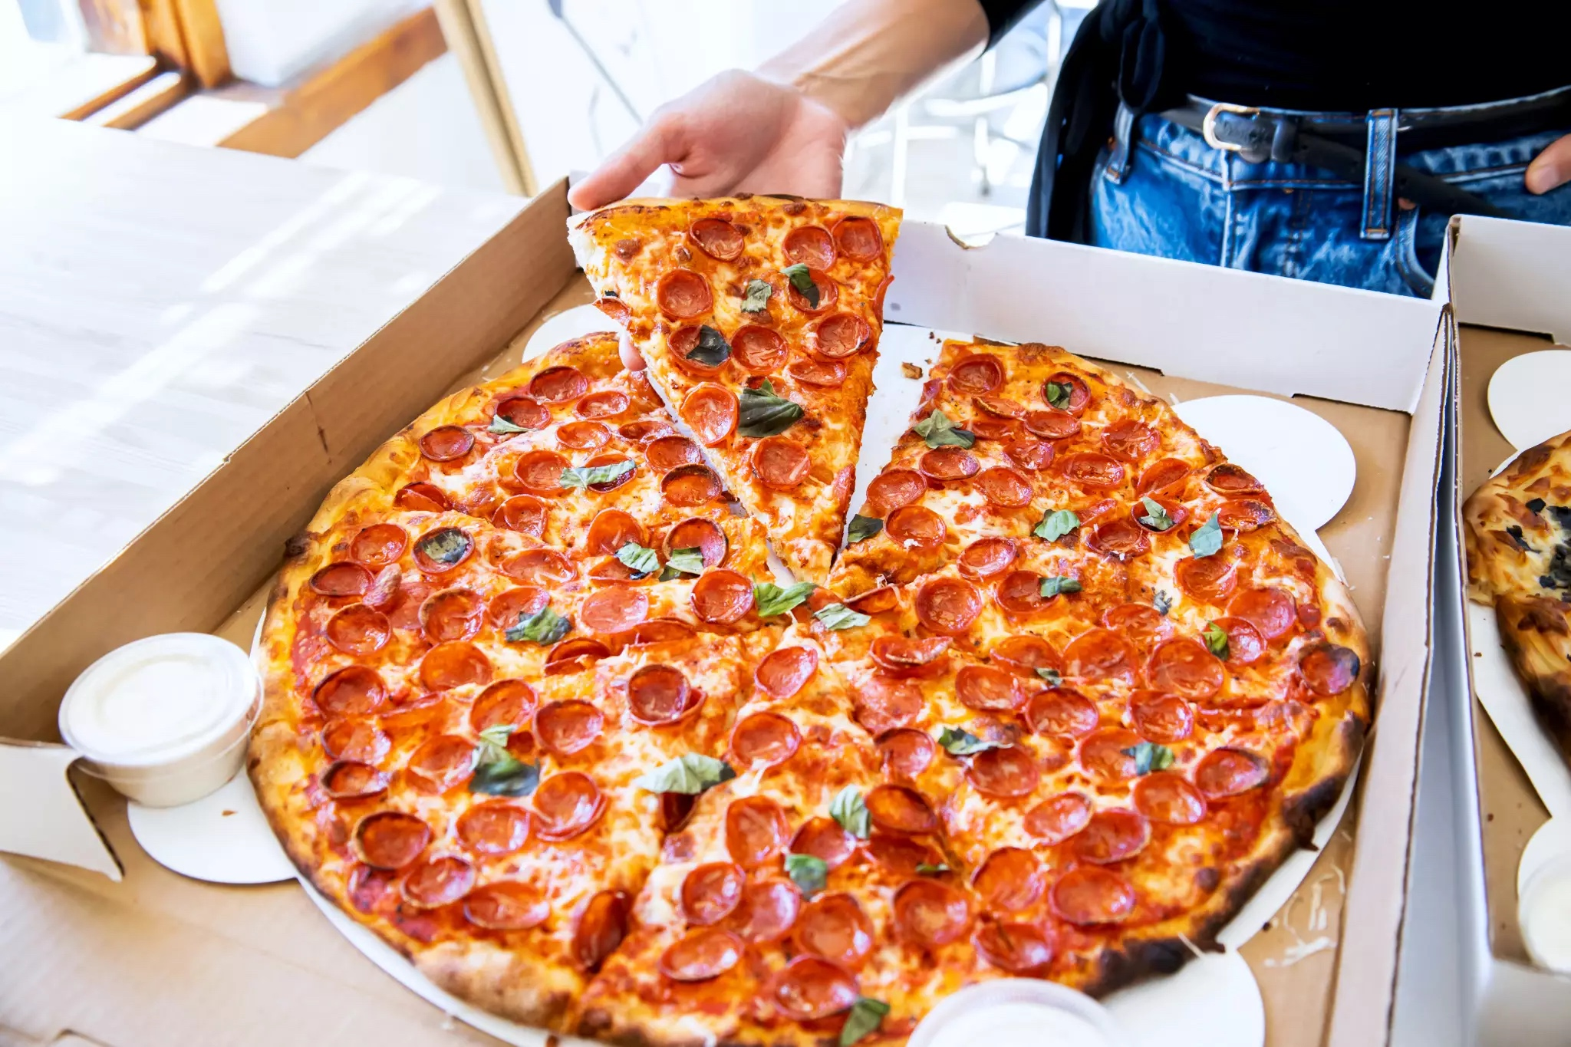
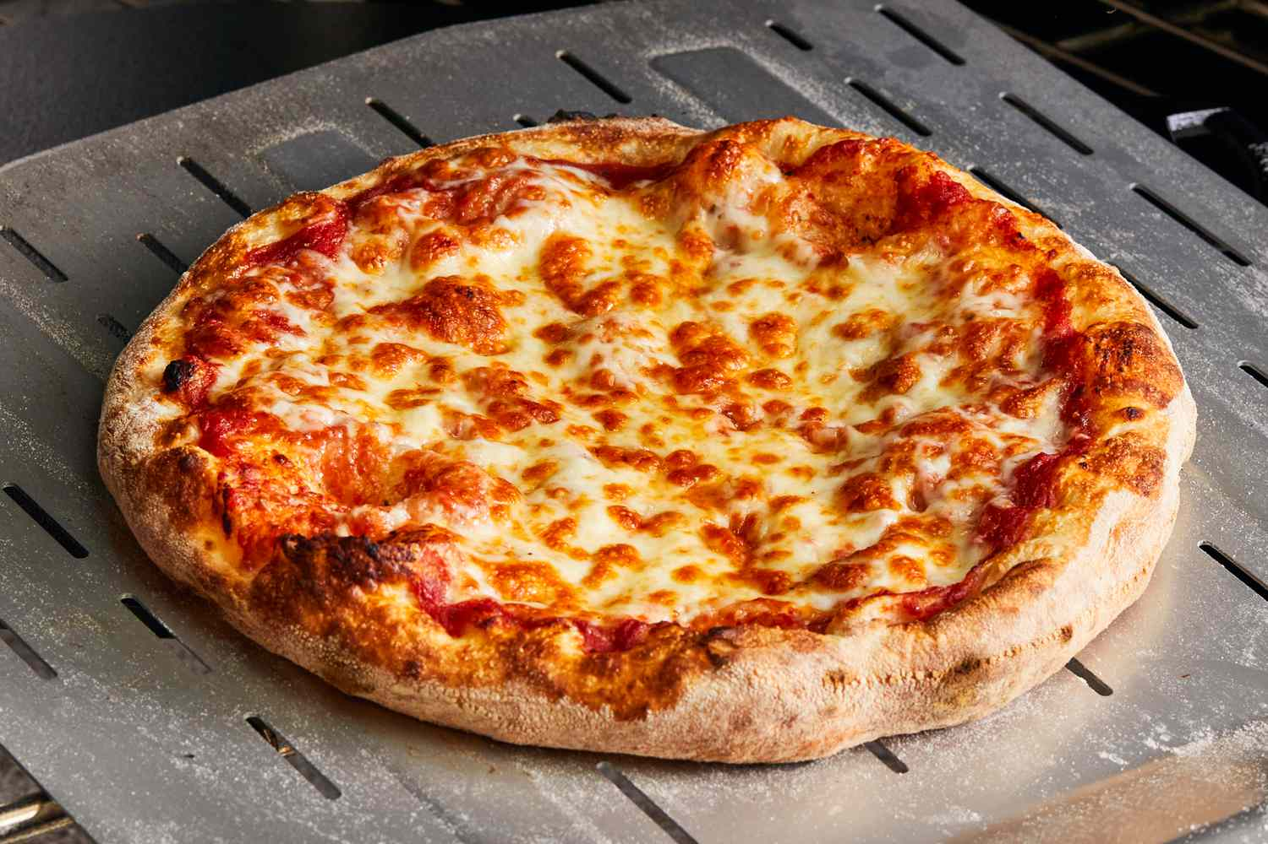
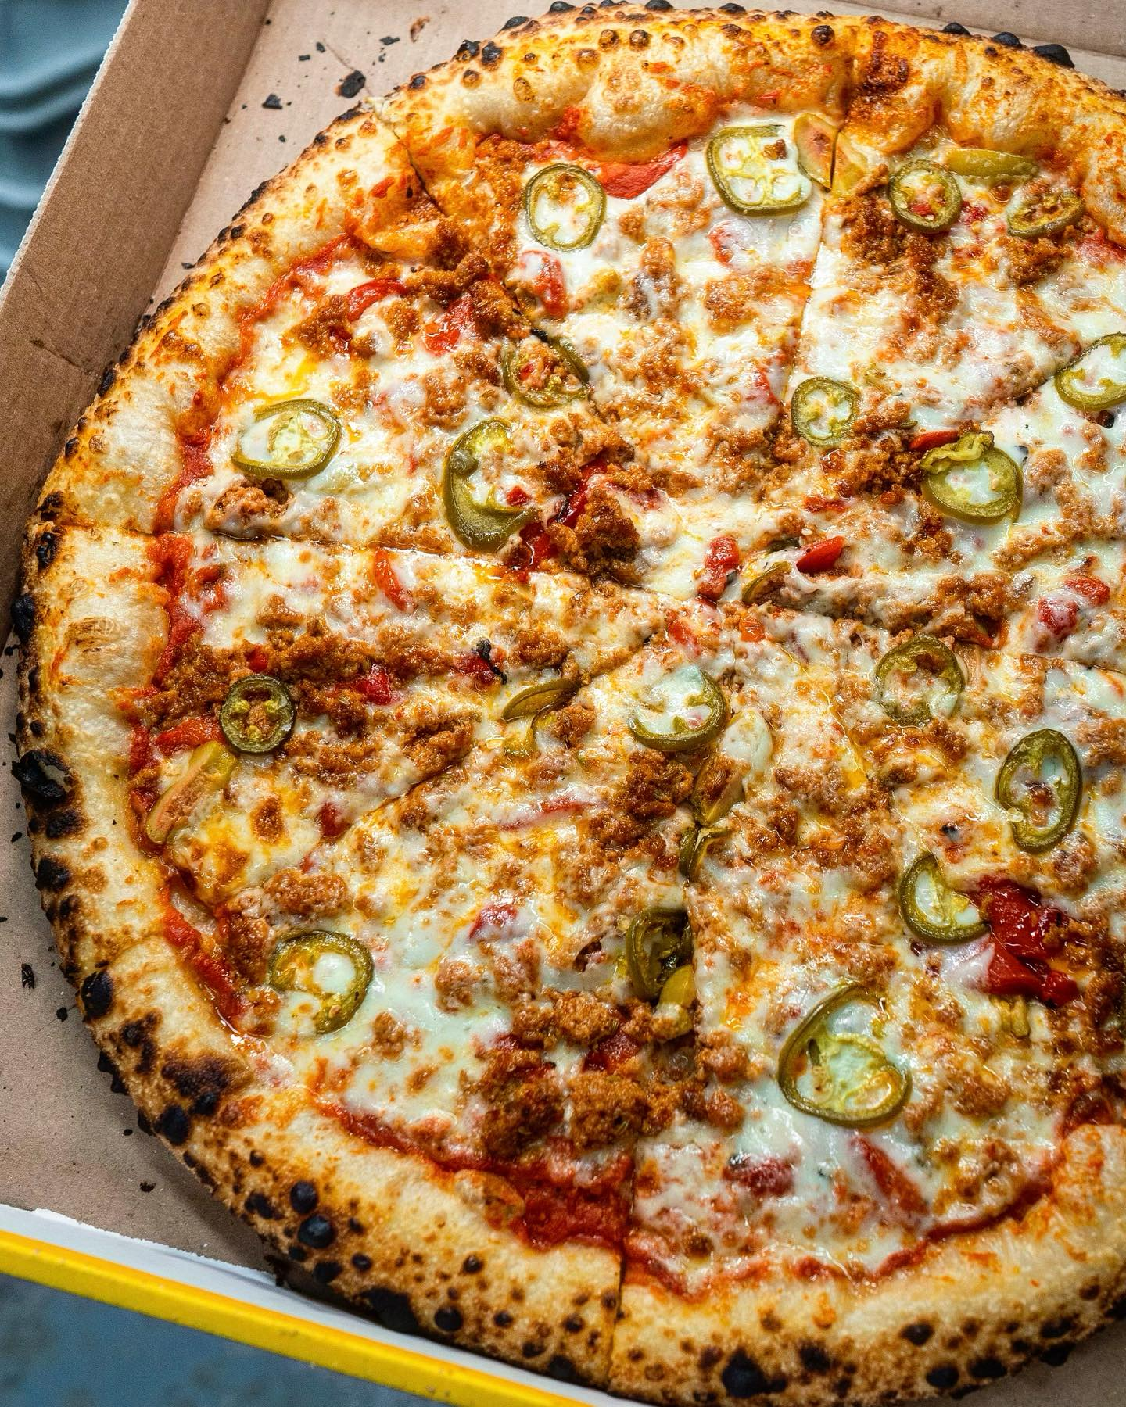

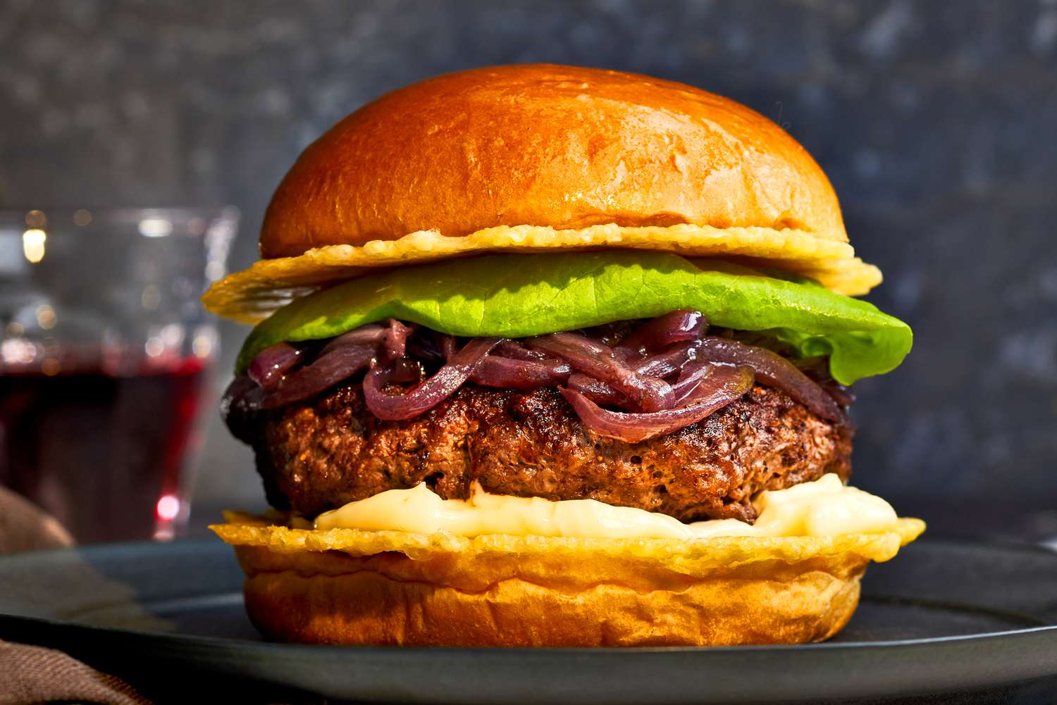
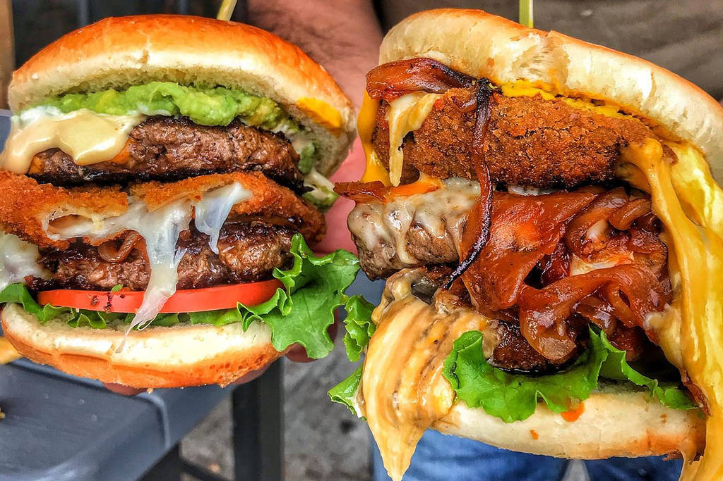
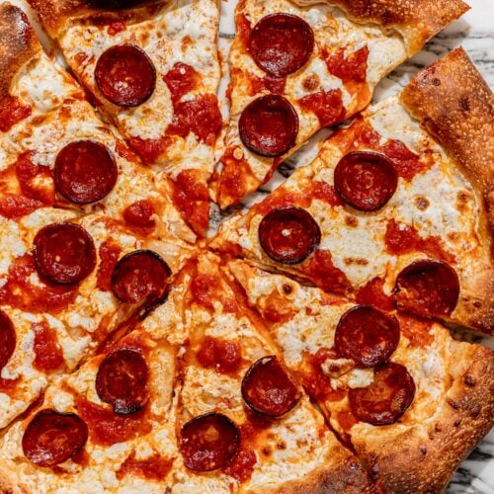



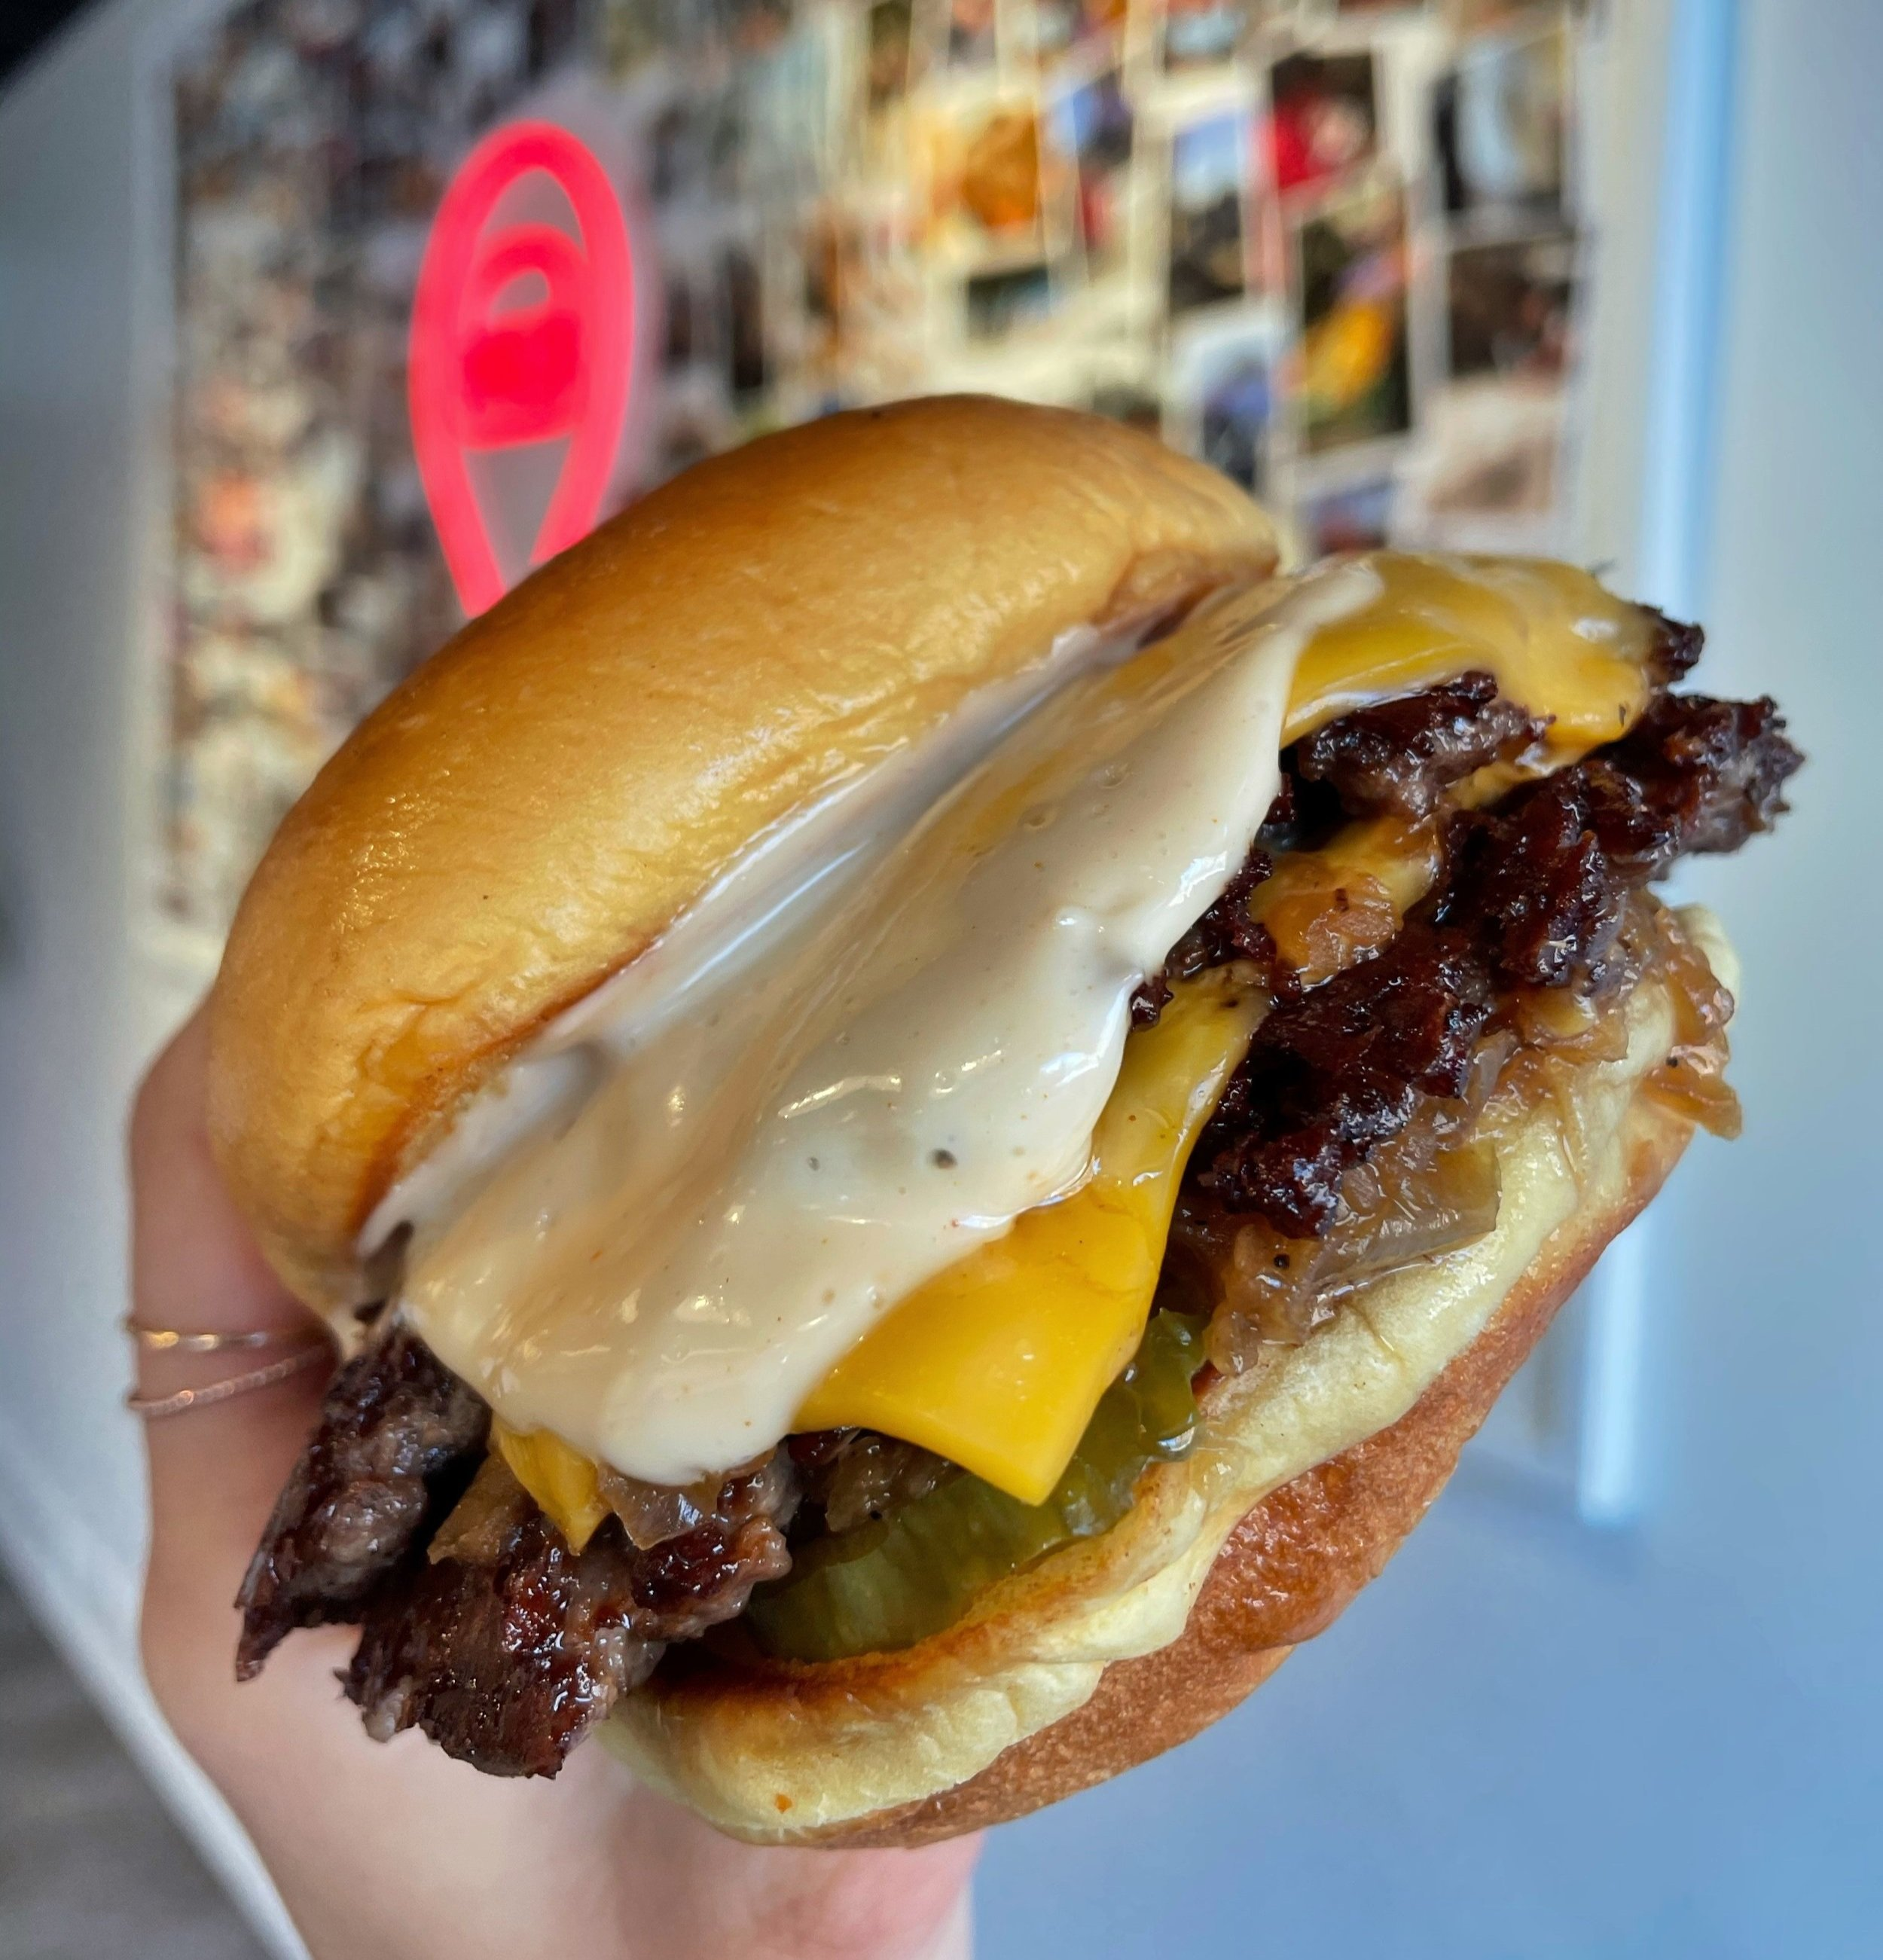
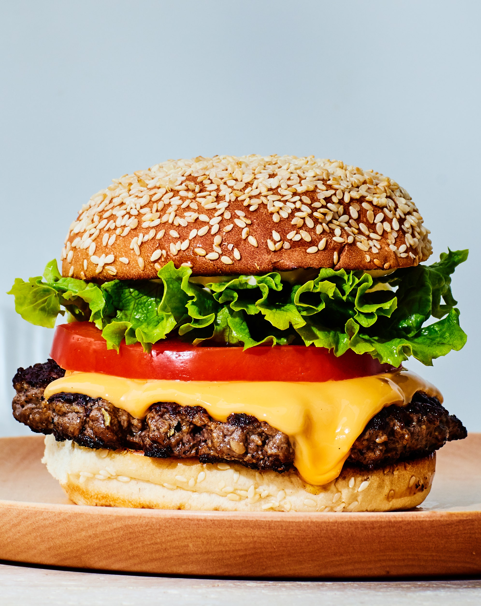
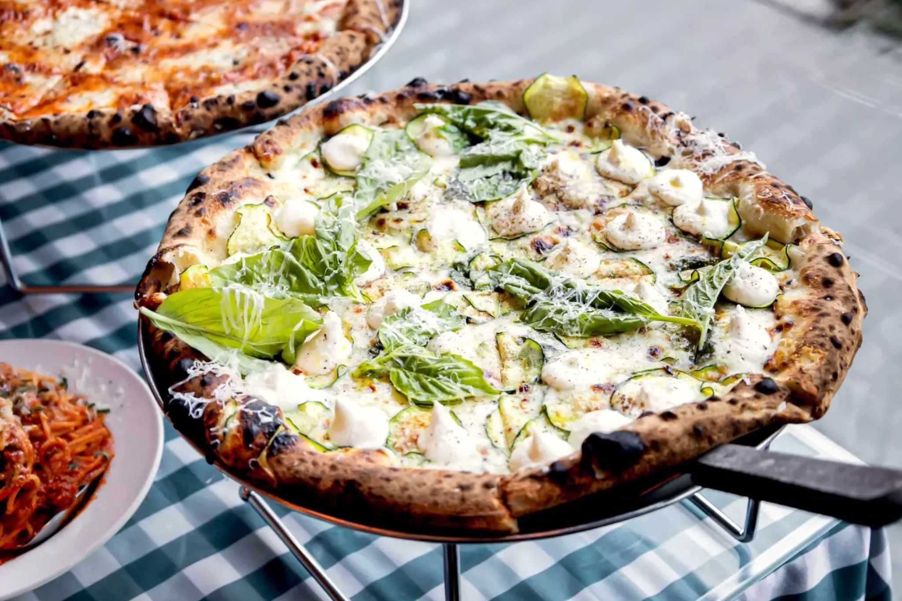
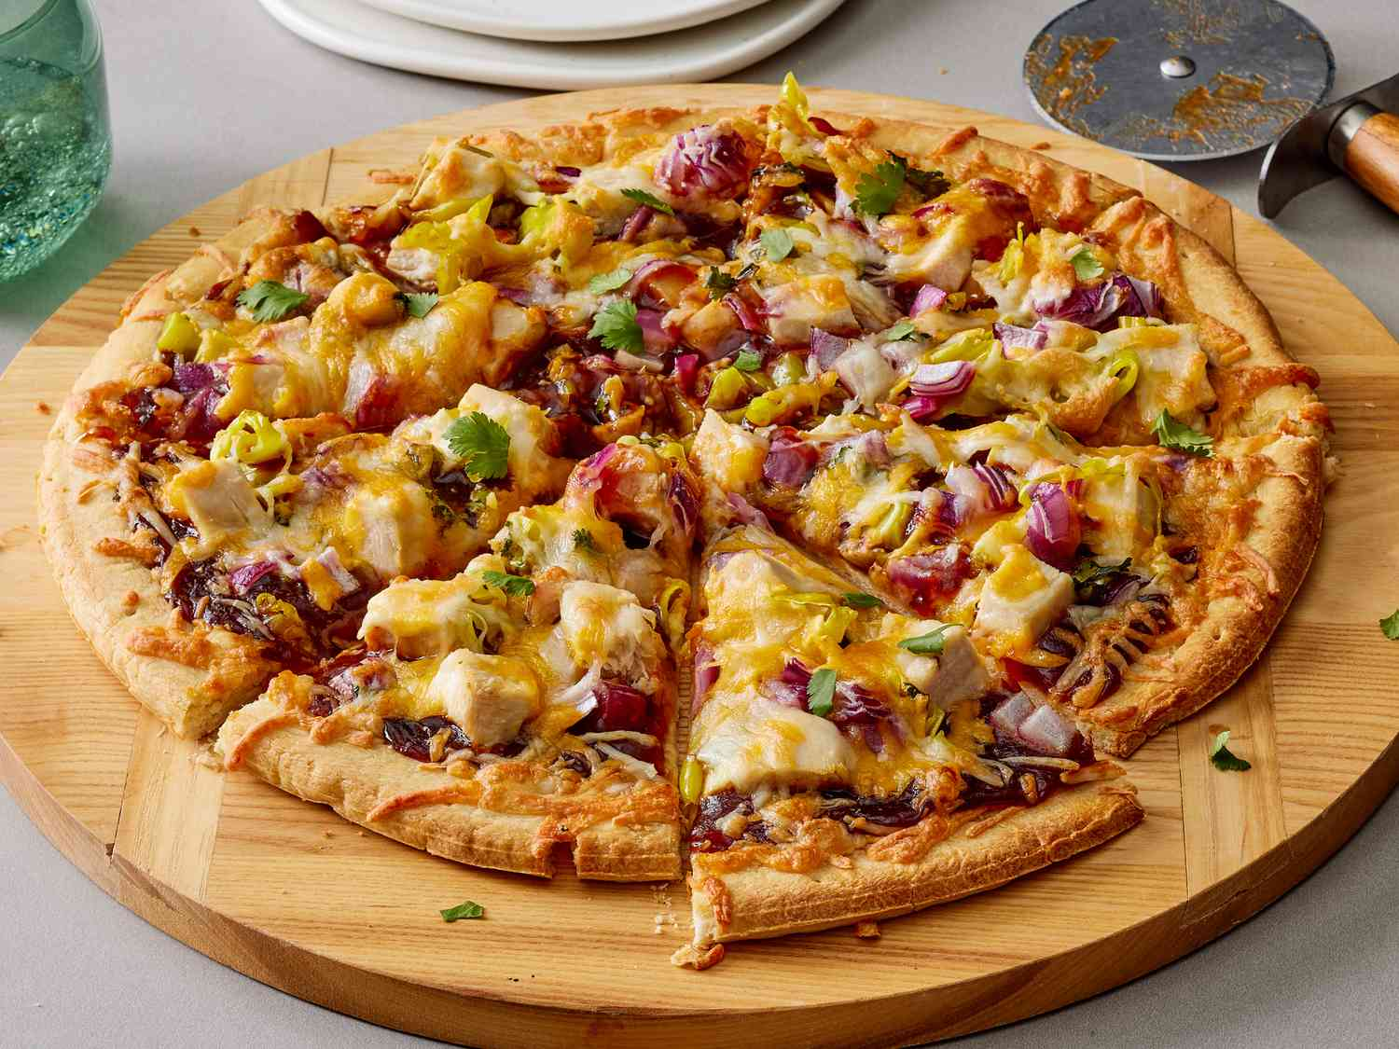


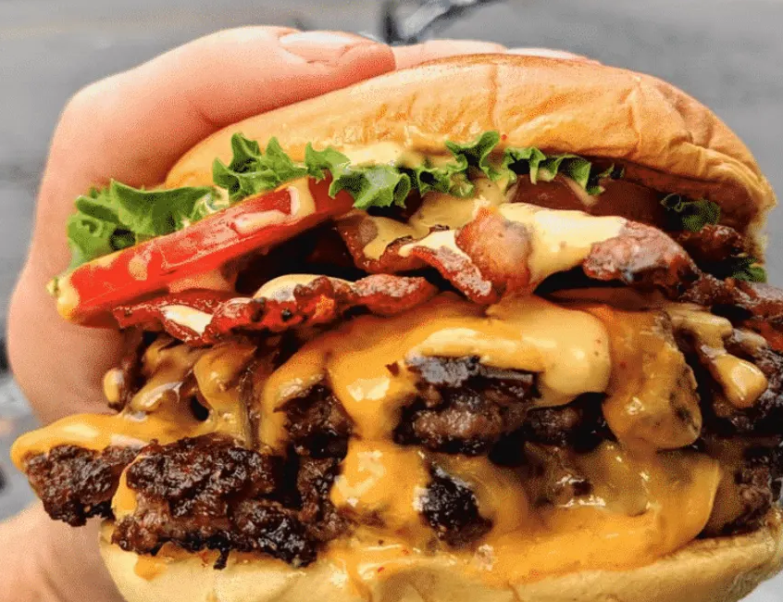
Machine Learning Approaches
Supervised Learning
Model is trained on labeled data.
Classification: predict categorical outputs. Can be binary or multi-class.
Regression: predict numerical values.
Algorithms include:
Regression
Support vector machines
Decision trees
BINARY CLASSIFICATION
MULTI-CLASS CLASSIFICATION

Slide 5
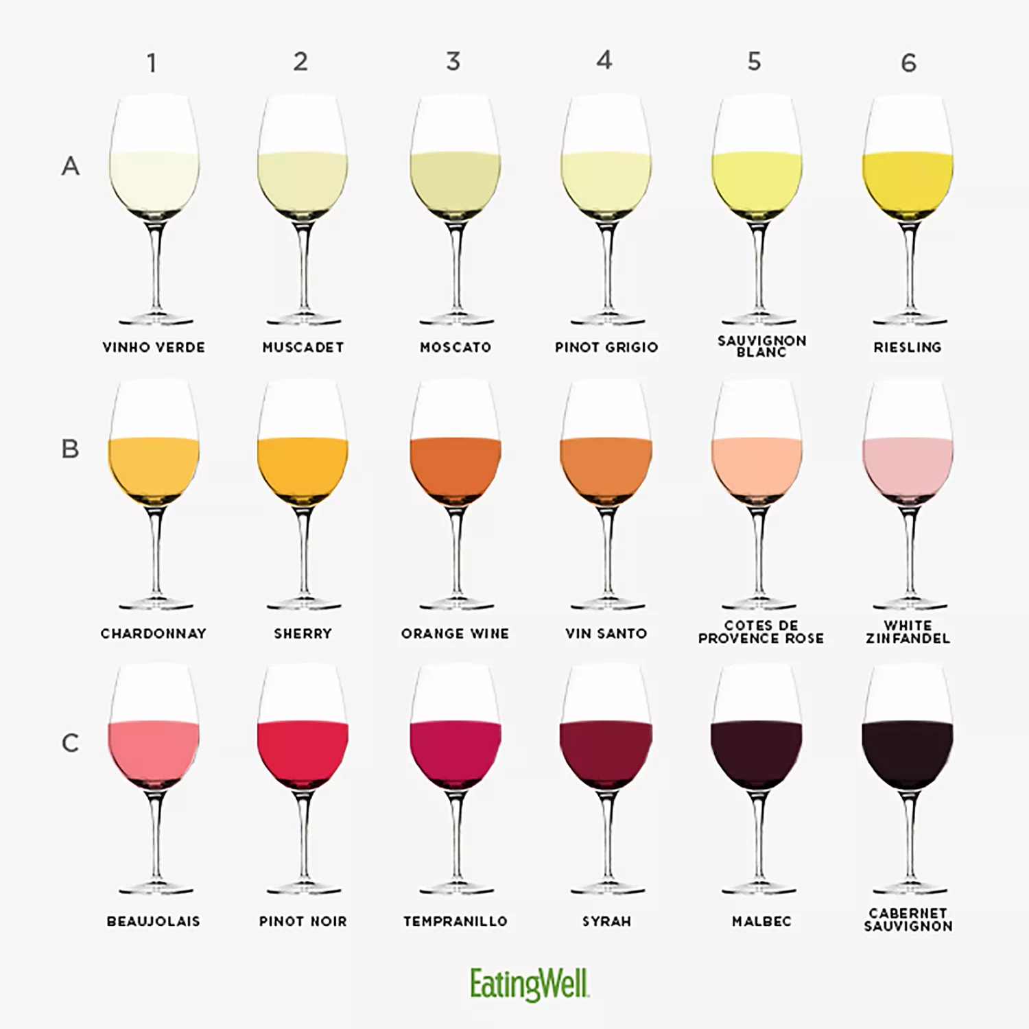
Machine Learning Approaches
Supervised Learning
Unsupervised Learning
Model is trained on labeled data.
Classification: predict categorical outputs. Can be binary or multi-class.
Regression: predict numerical values.
Algorithms include:
Regression
Support vector machines
Decision trees
Model is trained on unlabeled data.
Clustering: find sub-groups in the data.
Dimensionality reduction: reduce the number of features in the dataset without losing meaningful information.
Algorithms include:
K-means clustering
Hierarchical clustering
Principal components analysis
Dimension B
Dimension A

Slide 6
Machine Learning Approaches
Supervised Learning
Unsupervised Learning
Semi-supervised Learning
Reinforcement Learning
Model is trained on labeled data.
Classification: predict categorical outputs. Can be binary or multi-class.
Regression: predict numerical values.
Algorithms include:
Regression
Support vector machines
Decision trees
Model is trained on unlabeled data.
Clustering: find sub-groups in the data.
Dimensionality reduction: reduce the number of features in the dataset without losing meaningful information.
Algorithms include:
K-means clustering
Hierarchical clustering
Principal components analysis
Model is trained on both labeled and unlabeled data.
Unlabeled data help identify patterns in the dataset while labeled data establish structure and guide learning (how many classes in the dataset?).
Useful when working with limited or incompletely labeled data.
Model is trained to learn from positive (reward) and negative (punishment) feedback.
Algorithms include:
Value iteration
Markov decision process
Q learning
Useful when learning can be sequential.
LINK to more info

Slide 7
Introduction to Machine Learning
Inferential Statistics
Machine Learning
Data Collection
Data Collection
Data Preprocessing
Data Preprocessing
Model Specification
Model Specification
Model Evaluation
Model Training
Model Evaluation
Model Optimization
Predictions & Deployment

Slide 8
Data Collection
Feature Scaling
Feature Encoding
Data Preprocessing
Removal of Missing Values
Imputation of Missing Values
Dimensionality Reduction
Data Splitting
LINK to more info

Slide 9
Data Collection
Supervised Learning
Unsupervised Learning
Data Preprocessing
Regression
Support vector machines
Decision trees
K-means clustering
Hierarchical clustering
Principal components analysis
Model Specification
Semi-supervised Learning
Reinforcement Learning

Slide 10
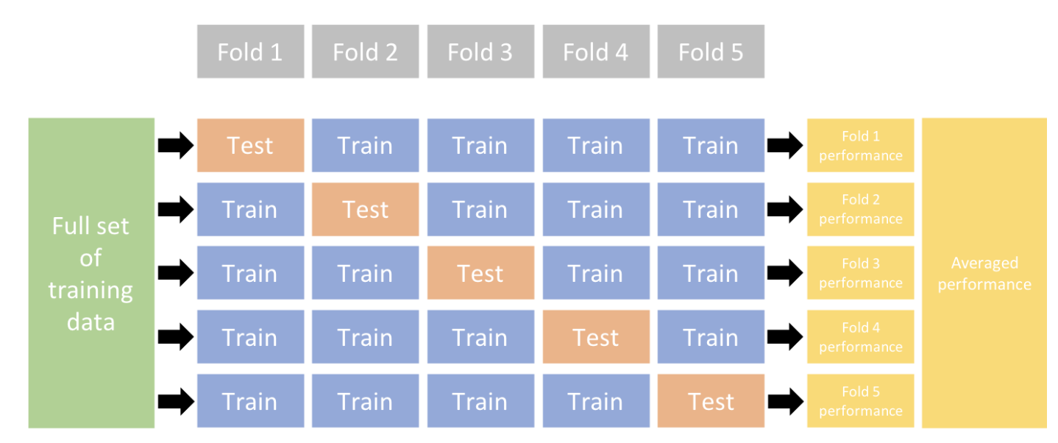
Data Collection
Data Preprocessing
Model Specification
TRAIN
TEST
Model Training
TRAIN
VALIDATE
TEST

Slide 11
Data Collection
Classification Models
Regression Models
Classification error
Cross-entropy
Mean squared error
Root mean squared error
Data Preprocessing
Mean squared error
Gini index
Mean absolute error
Deviance
Model Specification
Accuracy
Precision
R²
Model Training
Sensitivity (recall)
Specificity
Root mean squared log error
Area under the curve (AUC)
Model Evaluation
 |  | True Outcome
 |  | Yes | No
Predicted Outcome | Yes | True positive | False positive
 | No | False negative | True negative
LINK to more info

Slide 12
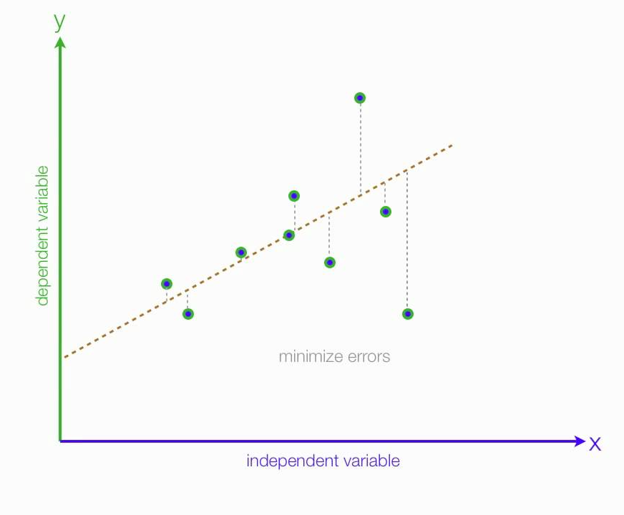
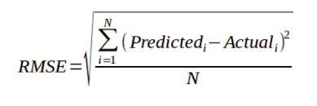
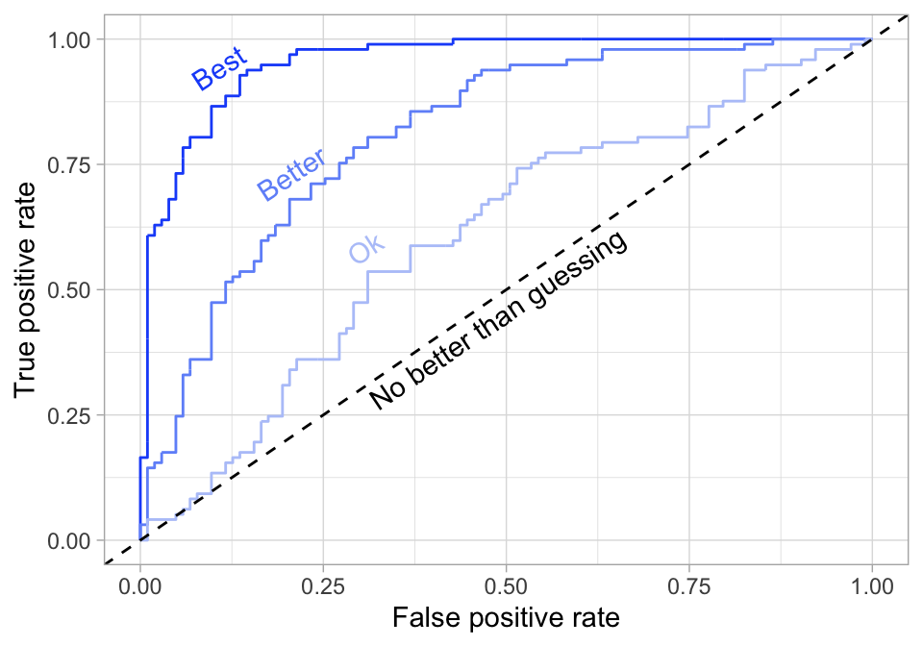
Data Collection
Classification Models
Regression Models
Classification error
Cross-entropy
Mean squared error
Root mean squared error
Data Preprocessing
Mean squared error
Gini index
Mean absolute error
Deviance
Model Specification
Accuracy
Precision
R²
Model Training
Sensitivity (recall)
Specificity
Root mean squared log error
Area under the curve (AUC)
Model Evaluation
LINK to more info

Slide 13
Model Optimization
Data Collection
Regularization
Pruning
Data Preprocessing
Parameter Tuning
Model Specification
Gradient descent
Stochastic gradient descent
Model Training
Hyperparameter Tuning
Model Evaluation
Grid search
Random search
Model Optimization
Bayesian optimization
Predictions & Deployment
LINK to more info

Slide 14
CODING PRACTICE

Slide 15
Framingham Heart Study
One of the longest prospective epidemiological studies of cardiovascular disease and its risk factors.
Began in 1948 in Framingham, MA
Initially enrolled 5209 men and women aged 29-62 years old.
Followed them over time, with assessments every 2 years.
Examinations included:
Detailed medical history
Physical exams
Lab tests
Lifestyle and habits
Noninvasive imaging

Slide 16
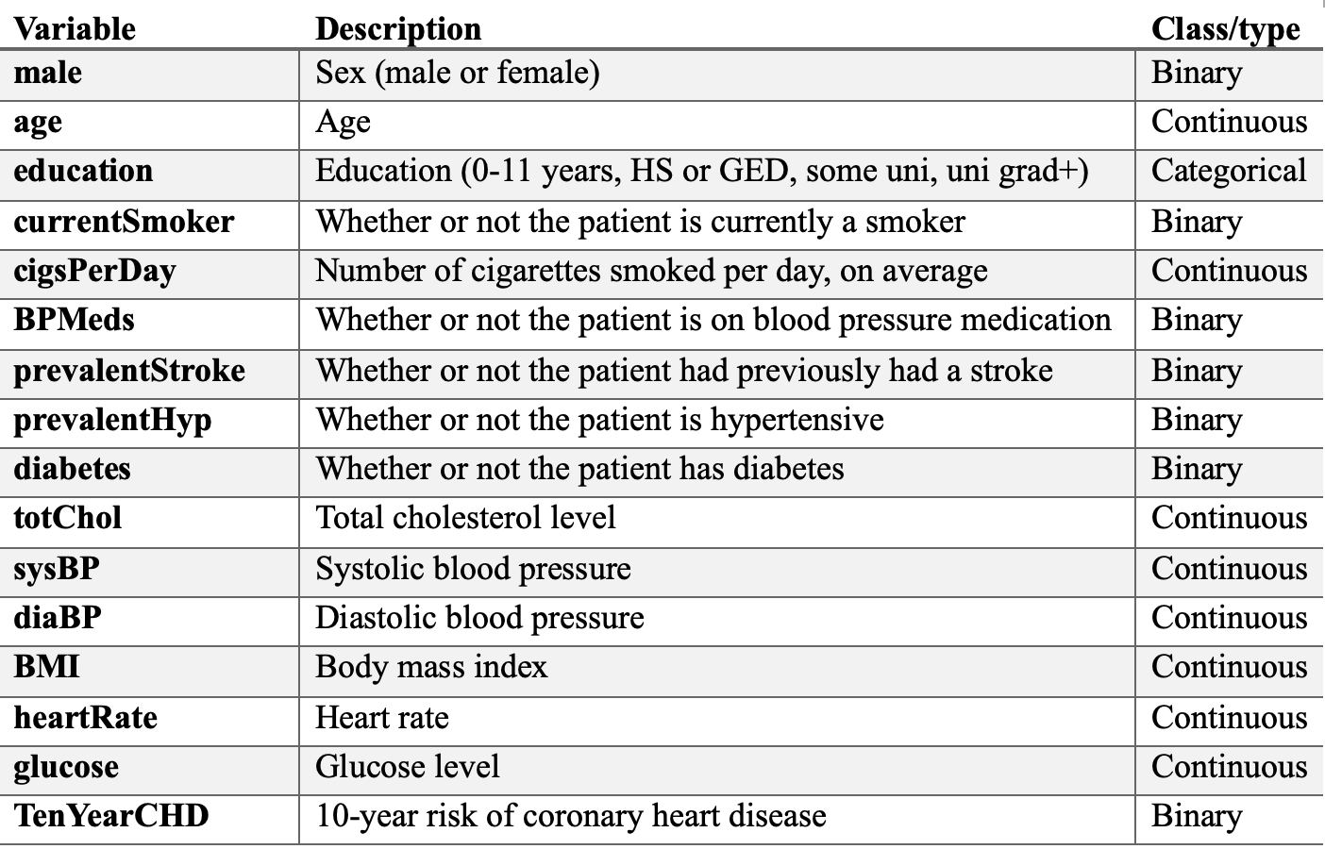
Framingham Heart Study Dataset
Subset of the data with 4000+ records and 16 variables.
(https://www.kaggle.com/datasets/captainozlem/framingham-chd-preprocessed-data)

Slide 17
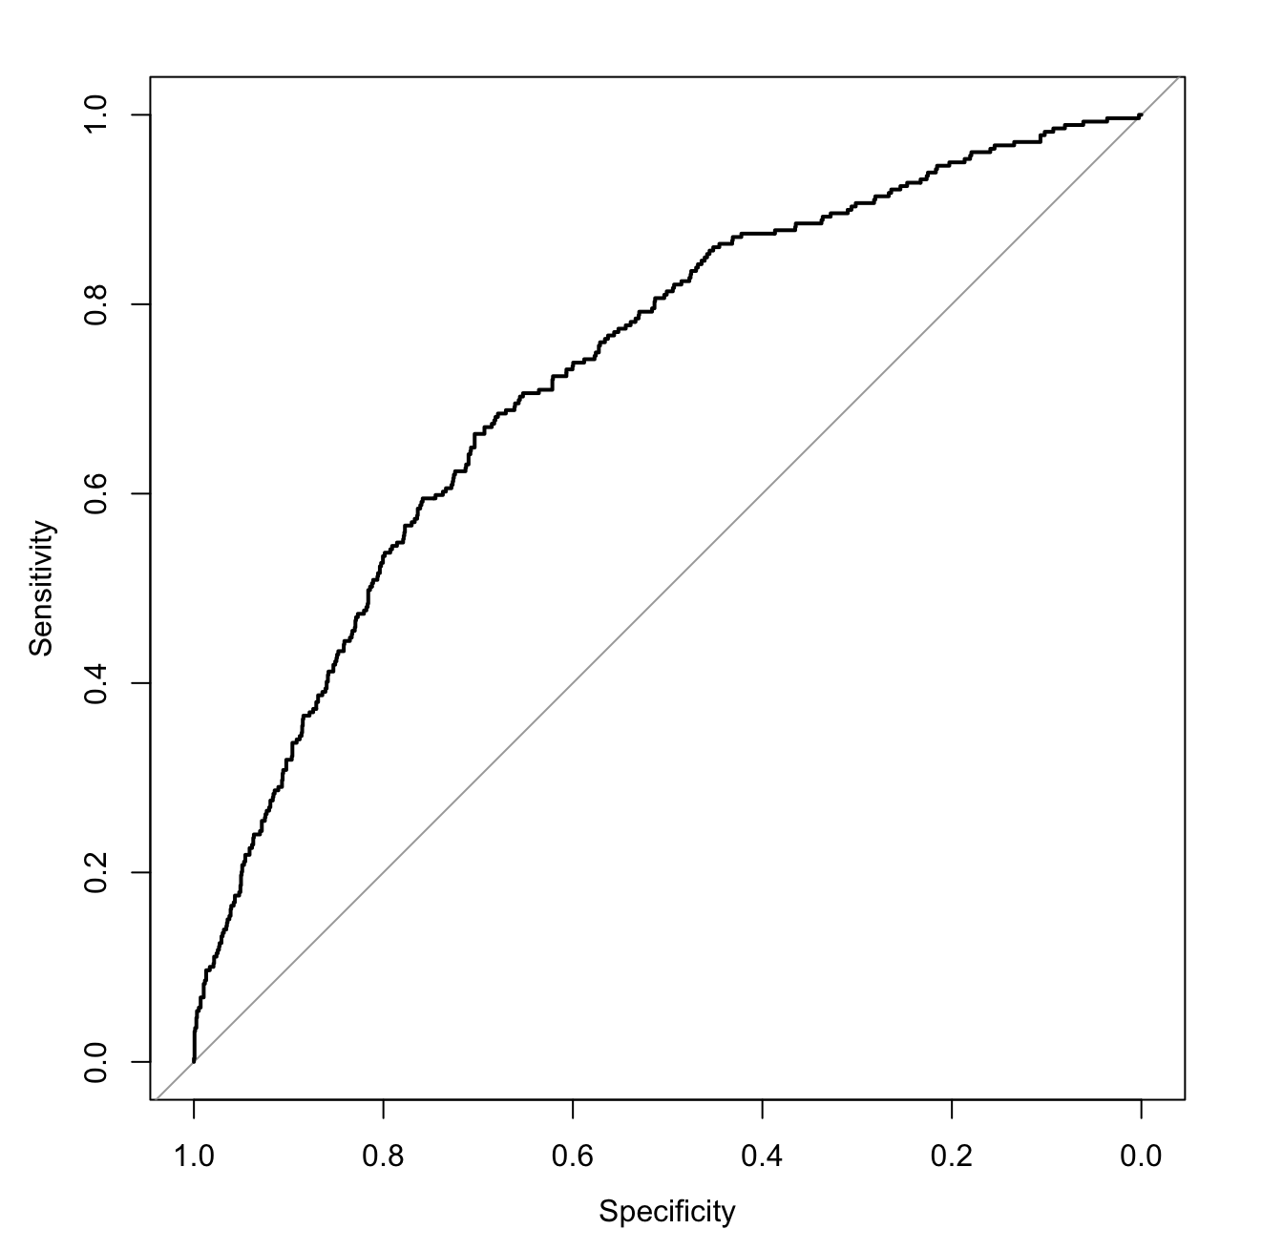
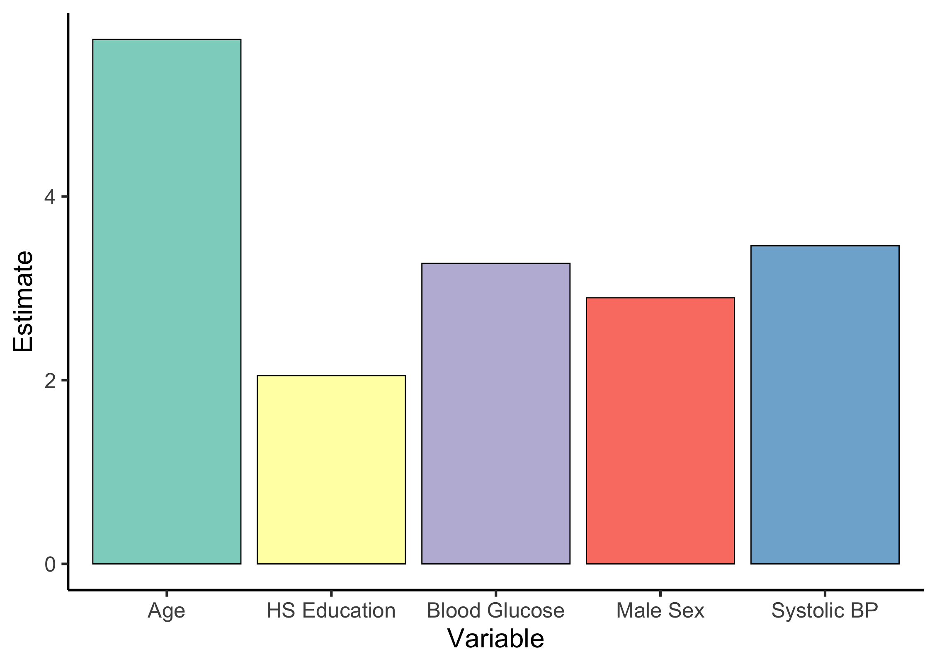
Binary Classification
Logistic Regression
Predictors: all variables
Outcome variable: heart disease
AUC = 0.7293

Slide 18
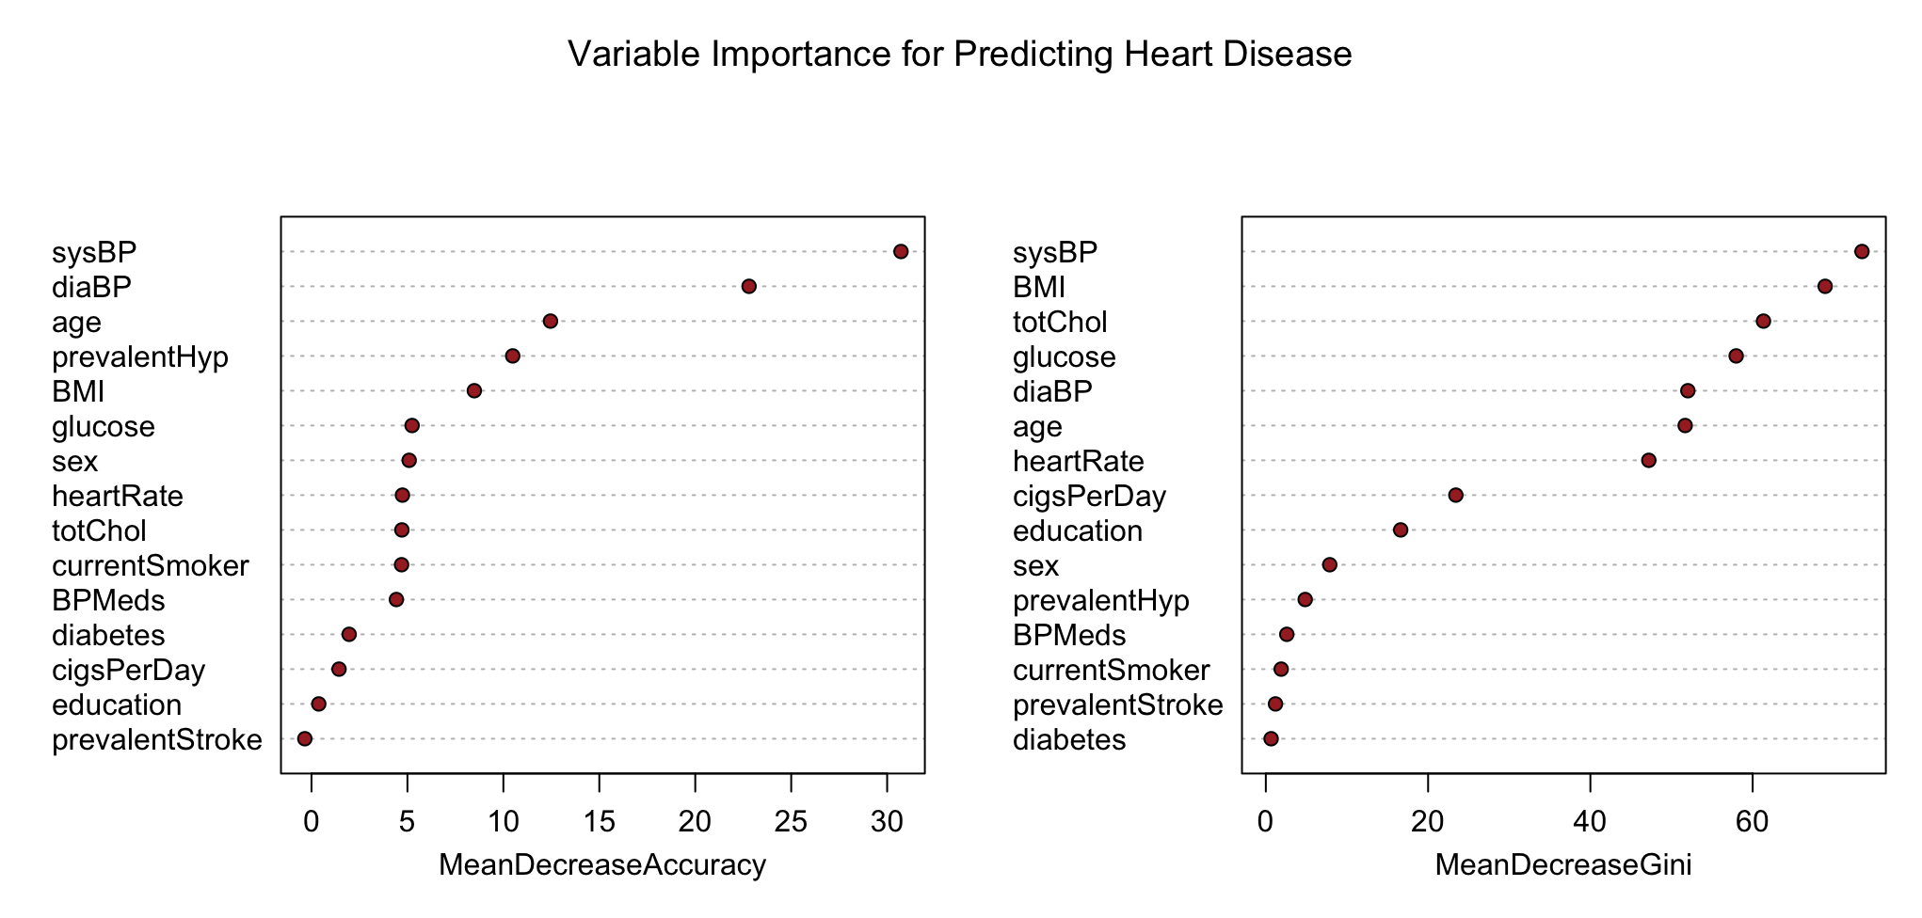
Binary Classification
Random Forest
Predictors: all variables
Outcome variable: heart disease
Notes:
Better for multicollinear data

Slide 19
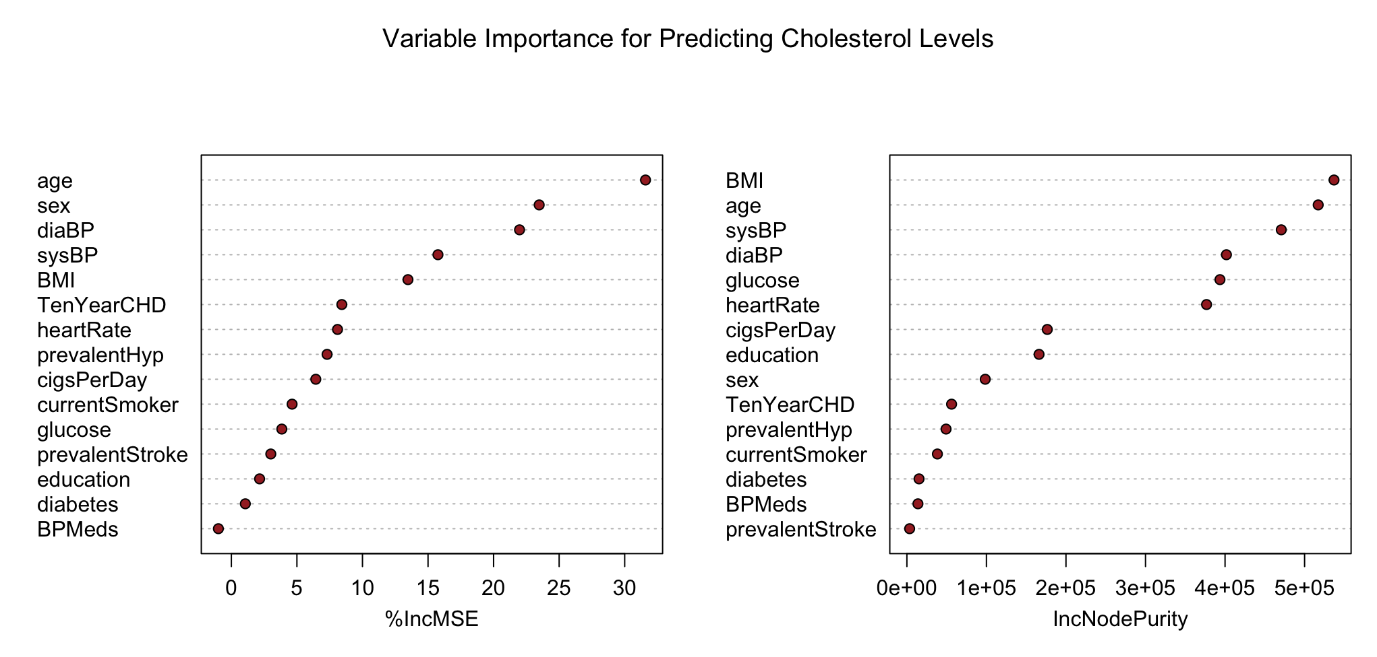
Regression
Random Forest
Predictors: all variables
Outcome variable: cholesterol levels
Notes:
Better for multicollinear data

Slide 20
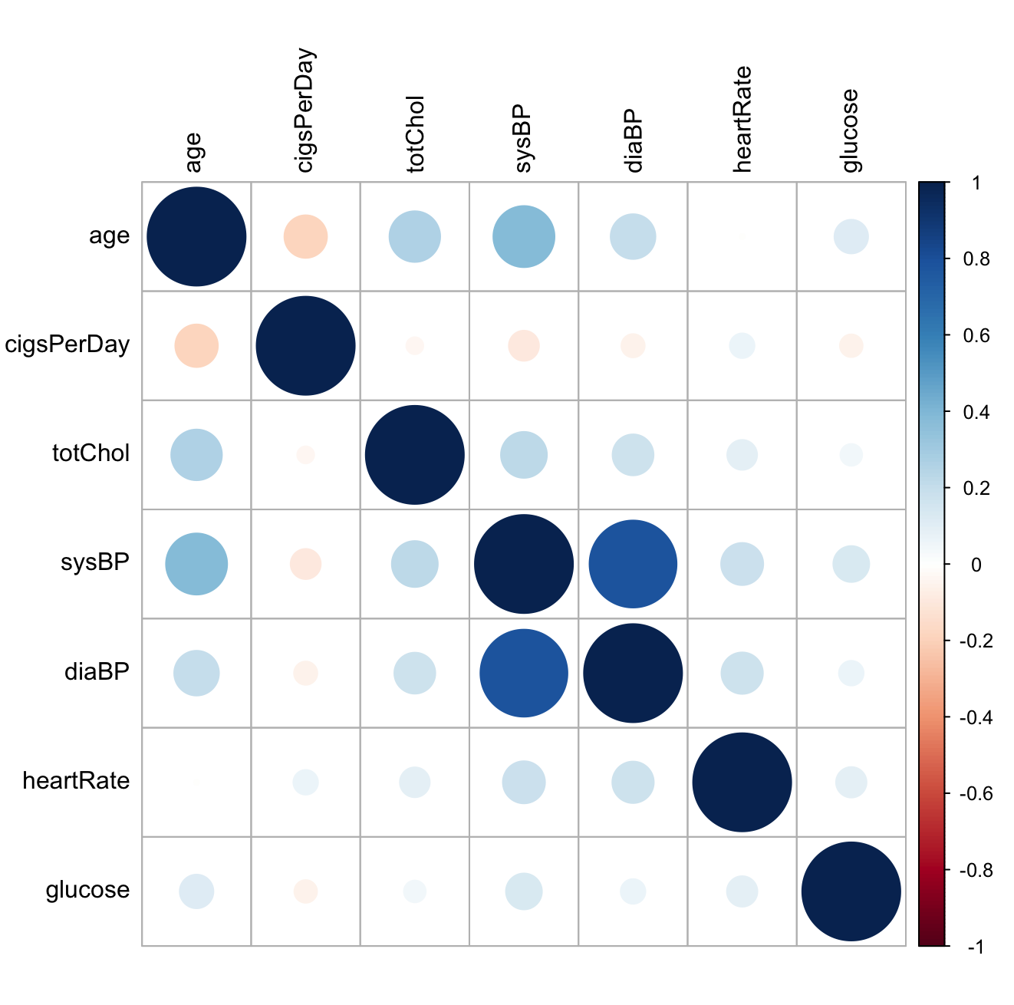
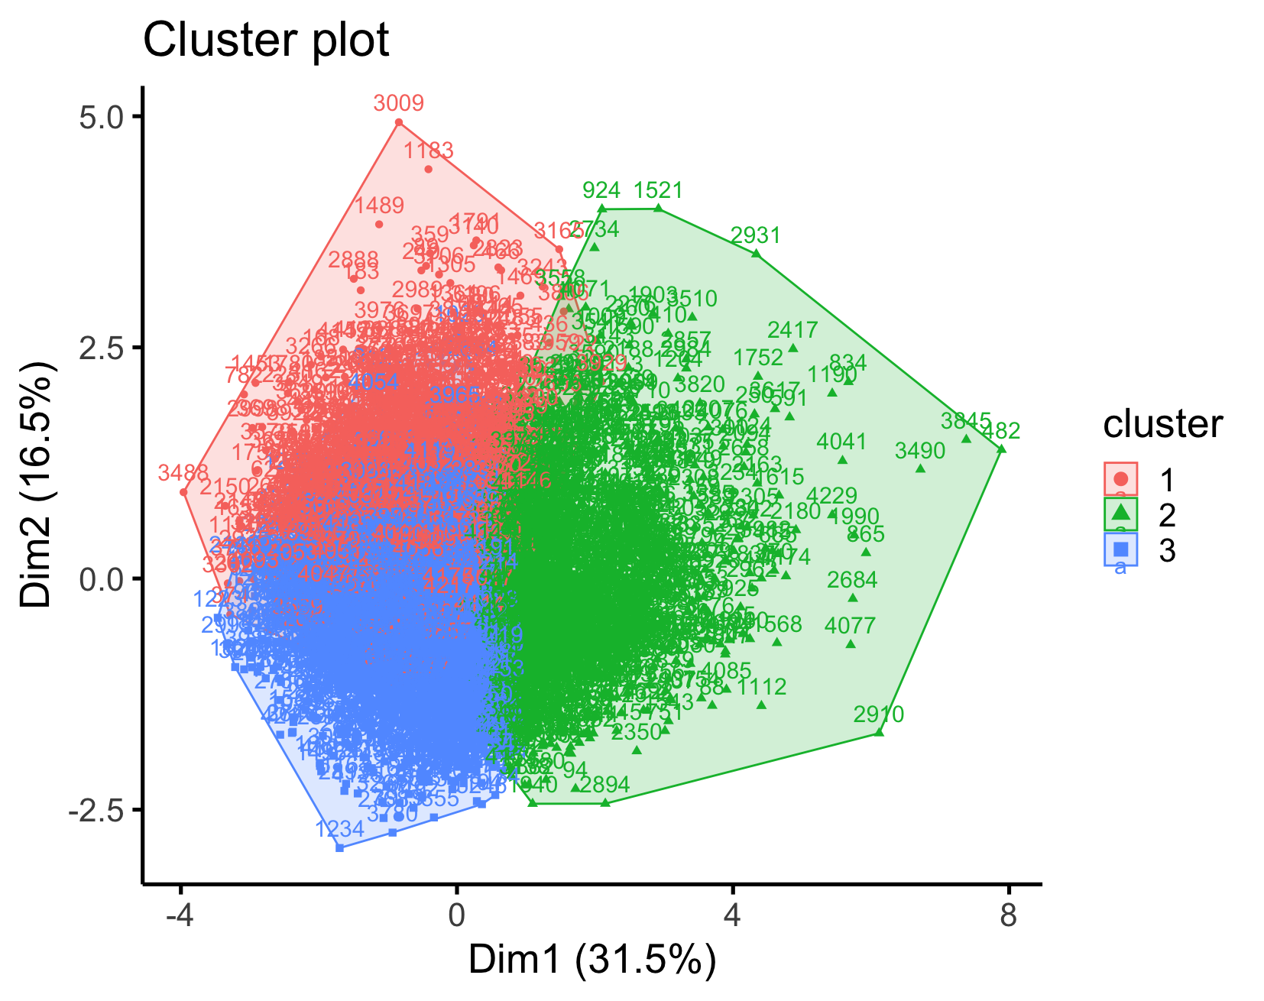
Clustering
K-means
Predictors: all numeric/continuous variables

Slide 21
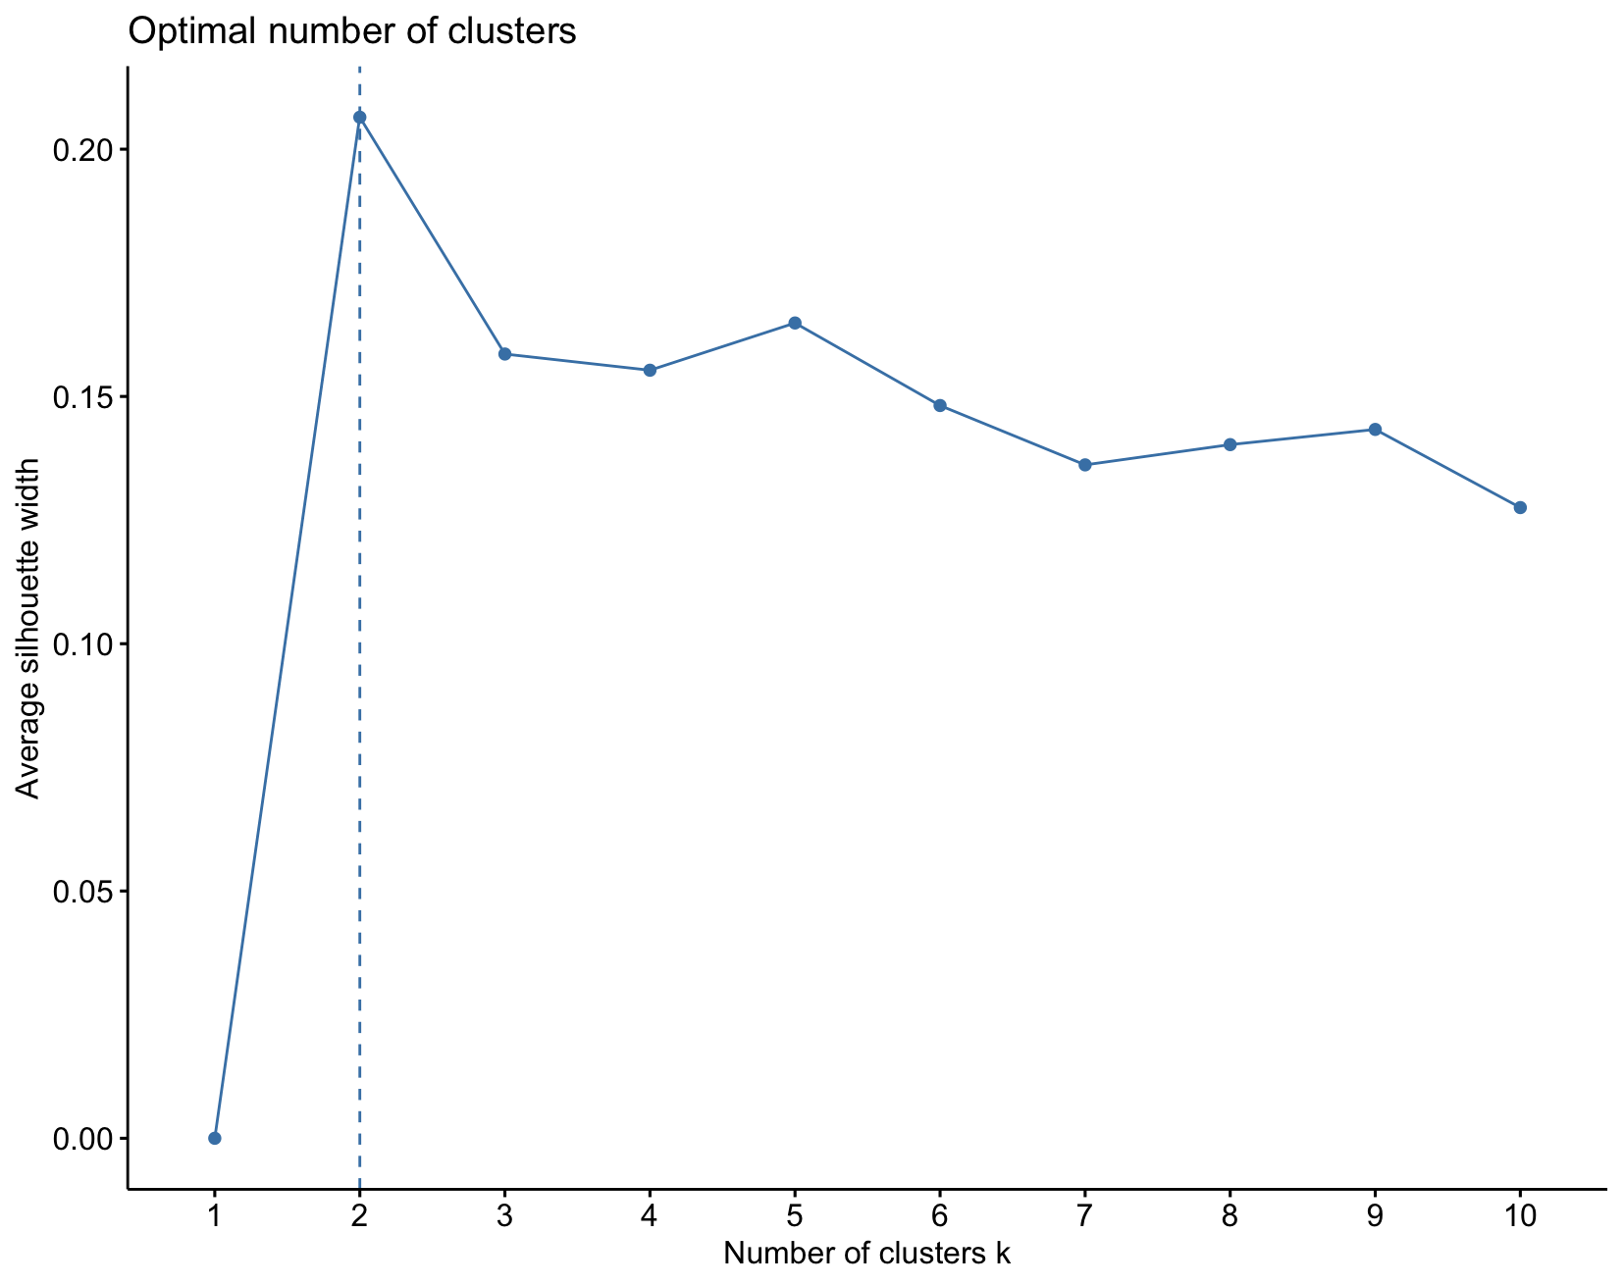
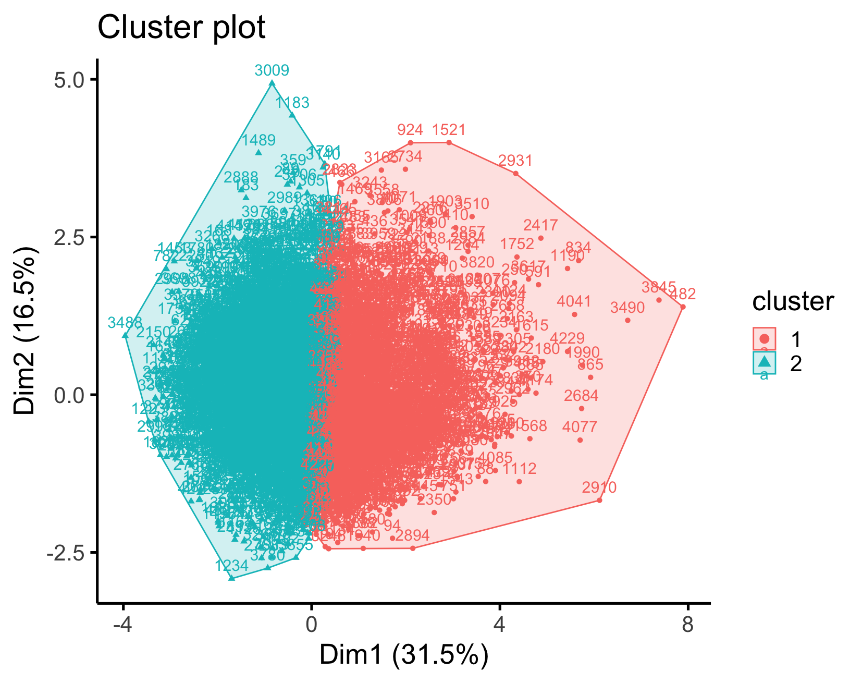
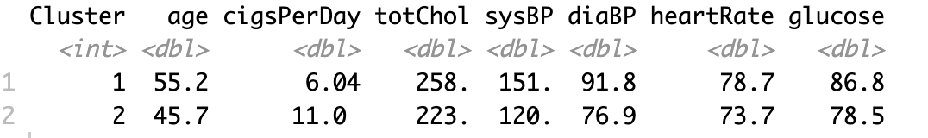
Clustering
K-means
Predictors: all numeric/continuous variables

